Slide 1

Session Name:
Solving Optimization Problems with Network Analysis
Delivered By:
Mr. Ritwik Sinha

Slide 2

Network Optimization Problems
Different prototype models of network optimization problems are:
Assignment Problem - Done
Critical Path
Max Flow
Shortest Path
Transportation - Done
Minimum Cost Flow Problem
Today we will be doing Critical Path and Shortest Path

Slide 3

Learning Objectives
By the end of this session, you will be able to:
Discuss Critical Path and Shortest Path network optimization problems
Discuss the applications and differences between the two methods

Slide 4
Shortest Path Vs Critical Path
Shortest Path – The shortest path aims to find the path between two nodes in a graph such that the total weight (or cost) is minimized. It is applicable to directed or undirected weighted graphs. Popular algorithms to solve Shortest path problem are: Djkstra’s Algorithm, Bellman-Ford, Floyd-Warshall. It finds its applications in GPS navigation, Network routing, Transportation and logistics, Robotics path planning.
Critical Path – The critical path in a project network is the longest path from start to end, determining the minimum completion time for the project. It is utilized in project management and scheduling. Contains nodes or edges that represent activities with specific durations. Popular algorithms to solve Critical Path problem are: PERT and CPM methods. It finds its applications in Construction and software project planning, Manufacturing.

Slide 5
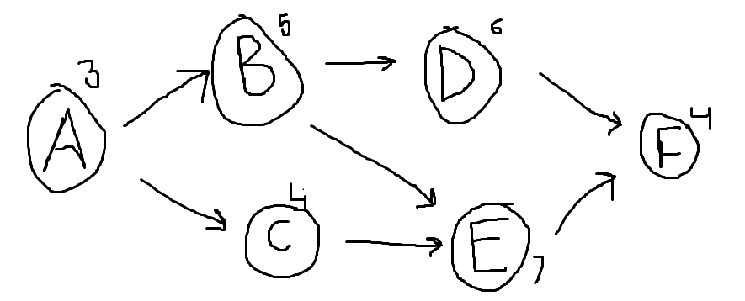
Critical Path Method – CPM
Task | Predecessor | Duration
A | - | 3
B | A | 5
C | A | 4
D | B | 6
E | B, C | 7
F | D, B | 4
A -> B -> D -> F = 3 + 5 + 6 + 4 = 18
A -> B -> E -> F = 3 + 5 + 7 + 4 = 19
A -> C -> E -> F = 3 + 4 + 7 + 4 = 18
The critical path (longest path, having highest duration) is A -> B -> E -> F

Slide 6
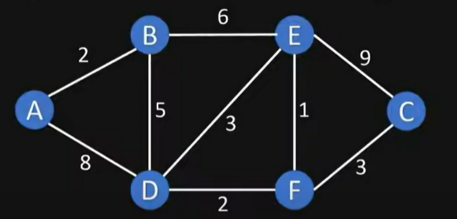
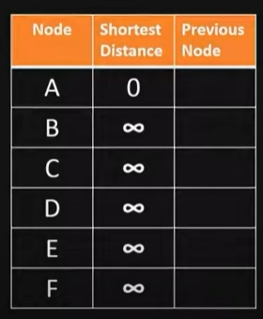
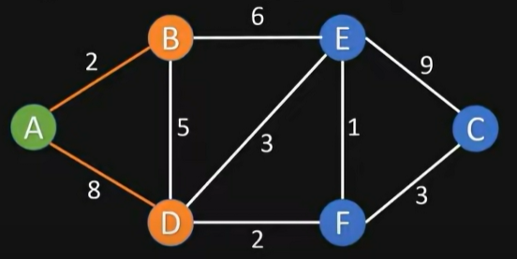
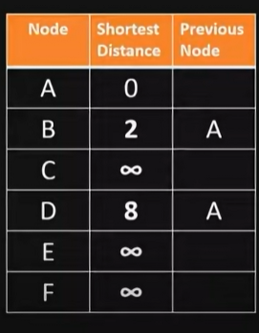
Shortest Path – Dijkstra Algorithm
Visited Nodes = []
Unvisited Nodes = [A, B, C, D, E, F]
Visited Nodes = [A]
Unvisited Nodes = [B, C, D, E, F]

Slide 7
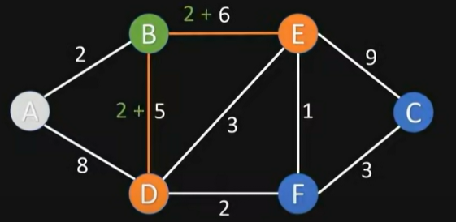
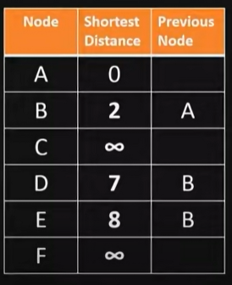
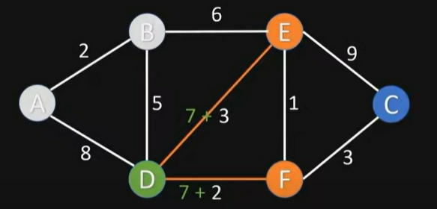
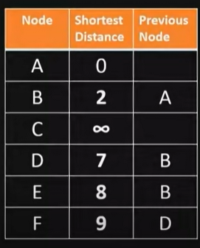
Shortest Path – Dijkstra Algorithm
Visited Nodes = [A, B]
Unvisited Nodes = [C, D, E, F]
Visited Nodes = [A, B, D]
Unvisited Nodes = [C, E, F]

Slide 8
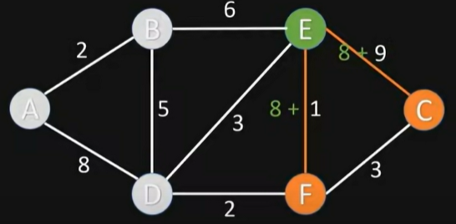
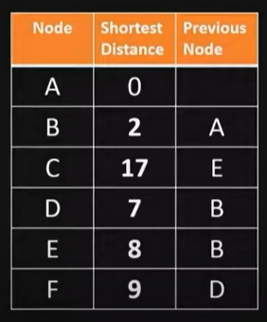
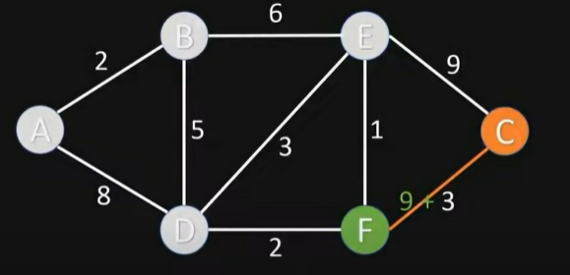
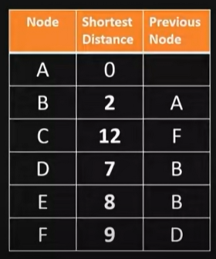
Shortest Path – Dijkstra Algorithm
Visited Nodes = [A, B, D, E]
Unvisited Nodes = [C, F]
Visited Nodes = [A, B, D, E, F, C]
Unvisited Nodes = []

Slide 9
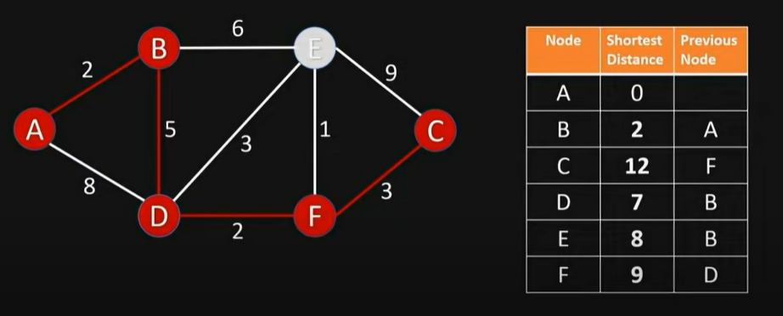
Shortest Path (From A to C) – Dijkstra Algorithm

Slide 10
Academic Poll
In Dijkstra’s algorithm, what is the initial distance to all nodes except the source?
A) Zero B) Negative Infinity C) One D) Infinity
What is the main condition for an activity to lie on the critical path?
A) It must have a cost greater than zero B) It must be the first activity in the project C) It must have zero float/slack time D) It must connect to the final node directly

Slide 11
Academic Poll
In Dijkstra’s algorithm, what is the initial distance to all nodes except the source?
A) Zero B) Negative Infinity C) One D) Infinity
What is the main condition for an activity to lie on the critical path?
A) It must have a cost greater than zero B) It must be the first activity in the project C) It must have zero float/slack time D) It must connect to the final node directly

Slide 12
Session Summary
In this session, we have discussed about:
Implementing Dijkstra algorithm for Shortest Path
Implementing Critical Path Method

Slide 13

Happy Learning!

